Slide 1
Design Modeling Exercise (3 hours)

Slide 2
Exercise
Goal: creating a design (SSD, SD, DCD)
For simplicity, assume you are designing a mobile app or rich-client (desktop) app
For simplicity, persistence (DB) is not required. You may assume that data (object instances) are already stored in RAM, and the newly created object instances also stays in RAM only.
Team arrangement
Please create an ad hoc team with your friends
You are encouraged (but not required) to form an ad hoc team with your project teammates
Each team should have 3-4 students
Teamwork is required.
Move your desks to allow easy discussion

Slide 3
Exercise
You are required to
Study the reference use case document and domain model
For each use case
Draw an SSD
Draw a sequence diagram (SD) for each system event (use GRASP patterns)
Draw a design class diagram (DCD)
Use a digital camera (phone) to capture your design (SSD, SD, DCD)
One team will be selected to show (share) your design to your classmates

Slide 4
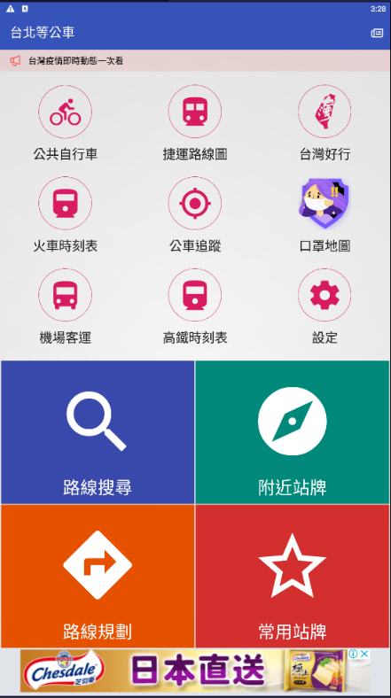
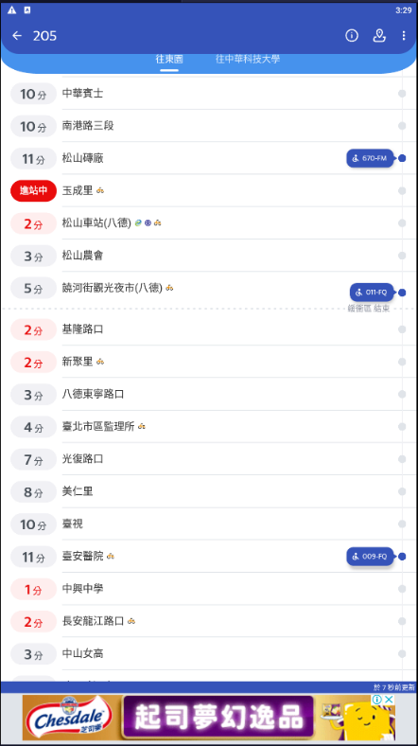
Exercise
Target App: 台北等公車(Google Play or App Store)
路線規劃 (Plan Route)的Happy Path
選擇起點、終點，搜尋路線，選擇路線，查看公車路線
常用站牌(Add Favorite)的Happy Path
新增常用站牌群組，加入常用站牌，選擇前往路線，查看公車路線
Upload deadline: Upload your design to Cyber classroom before 6/4 23:59PM

Slide 5
Lessons Learned
Was domain model useful?
Were you using GRASP patterns?
Were the design model created by different teams the same?
Was a team better than a single person?
Which team created the “best” design?
Did every team member understand the design?
Could your design model support two or more user interfaces?
After design modeling, can the coding be developed by several team members at the same time?

